Slide 1
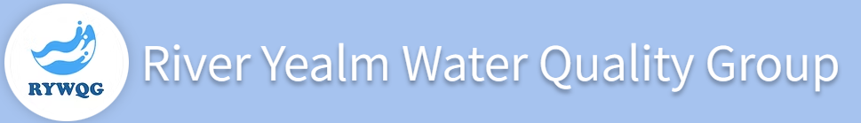
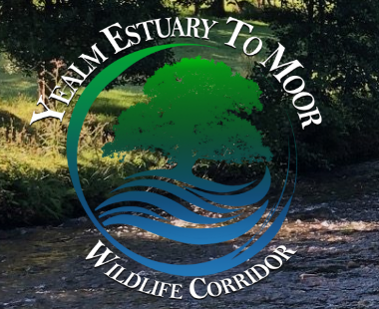
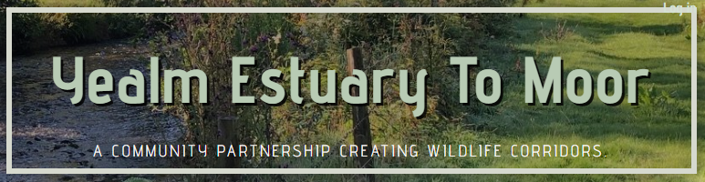
Community Led Projects
Dan Thomas, Deputy Leader SHDC
Ward Member for Newton & Yealmpton Ward
County Councillor for South Brent & Yealmpton Division, DCC

Slide 2

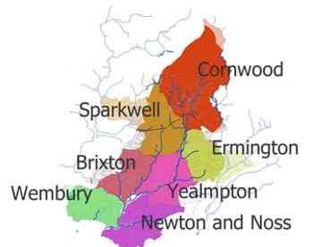
The Carrot and the Stick…
In the words of Diane Castle, Chair of Yealm Estuary to Moor, YEM and the RYWQG are symbiotic. In many ways, they act as the carrot and the stick. While both collect data, it can be used in different ways.
YEM aims for positive relationships with other stakeholders, such as the Nature Based Solutions Team at SWW. YEM looks to make change happen through collaborative partnerships. The RYWQG is more pressure based and lobby SWW for data or use FOI requests.
Both are entirely community led but are striving to improve the quality of our rivers.
Q. What has two arms and runs for 12km?
A. The River Yealm Water Quality Group and the Yealm Estuary to Moor group. Two arms, get it? One arm, the RYWQG deals primarily with water quality (who would have guessed) and, the focus of the other arm YEM, is to build a riparian corridor, by creating links to existing habitats along the 12km stretch of the river Yealm. The two groups work side by side.

Slide 3
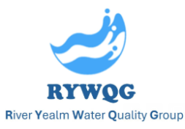
The River Yealm bubbles up through granite fissures clean and pure at Yealm Head above Cornwood. However, this life-giving arterial flow does not stay uncontaminated, treated by some as an open drain on its journey to the estuary.
The RYWQG was set up in 2021 and comprises of representatives from each of Yealm’s seven riparian Parish Councils:
Brixton, Cornwood, Ermington, Newton & Noss, Sparkwell, Wembury and Yealmpton
It includes local people and organisations concerned about river water quality, which may be influenced by inputs of treated and untreated sewage, industrial and/or agricultural waste.
RYWQG meets every two months, Chaired by Councillor Liz Hitchins of Brixton
Parish Council.

Slide 4
Activities;
Measuring river water quality and ecological status;
​Identifying and reporting upon specific areas of concern;
​Developing catchment-wide partnerships;
​Assessing strategic opportunities; and
Raising public awareness of river water quality issues.
Main findings;
​Historic analyses of water quality;
​“Yealm Dippers” Westcountry Rivers Trust Citizen Science Investigation;
​Continuous Water Monitoring; and
​Riverfly surveying.
Shared initiatives;
​Pollution event reporting;
​Helping plan effective separation of surface water runoff from sewage;
​Assessing the potential for and benefits of designated Bathing Water Status;
​Pollution associated with International Paint Ltd - Akzo Nobel;
​Scrutiny Group, assessing South West Waters plans;
​Yealm Catchment Plan; and
​Yealm Mapper (GIS).

Slide 5
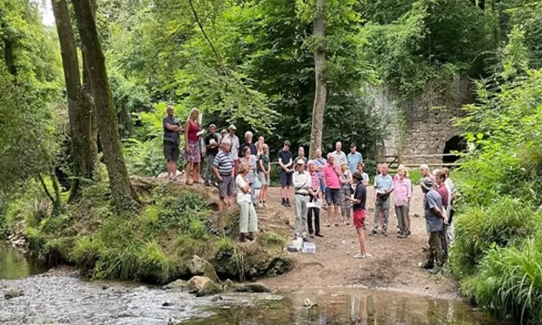
Measuring river water quality and ecological status
​
Helping enable and manage wider monitoring of river water quality and ecological health than is currently afforded by the Environment Agency, as we get to know our river:
​
by community volunteers known as “The Yealm Dippers, coordinated by the RYWQG and Yealm Estuary to Moor Project (YEM), with training and support from Westcountry Rivers Trust (WRT)​​ and WildFish, using equipment and consumables funded primarily by the Parish Councils of Wembury, Newton Ferrers, Noss Mayo, Yealmpton, Brixton and Cornwood, Sparkwell, including one significant anonymous donor;
​
monitoring 24 sites on a monthly basis, including on every significant tributary throughout the Yealm catchment, to help identify sites of low level background pollution as part of the WRT Citizen Science Investigation (CSI);
​
managing automated instruments purchased by the RYWQG (i.e. “The Yealm Sonde”), recording and alerting to higher level pollution incidents;
​
in collaboration with other organisations such as also include Plymouth Marine Laboratory and the University of Plymouth.
Credit: John Challenor

Slide 6
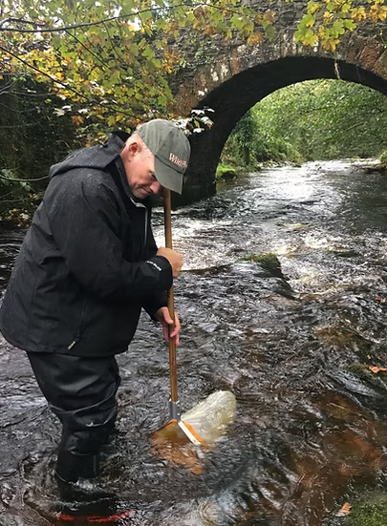
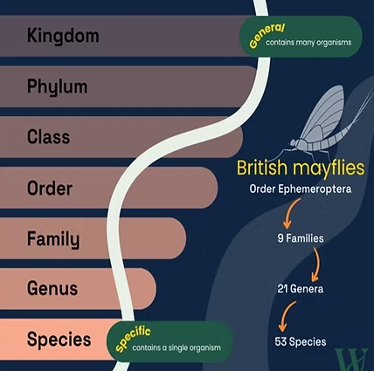
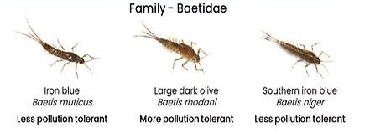
Riverfly survey
​
Aquatic insects known as riverflies are at the base of the food chains for many river species. To provide a recognised measure of ecological health, in partnership with WildFish’s SmartRivers Riverfly Census, “Yealm Dippers” are surveying riverfly diversity and abundance throughout our catchment.
Findings are being mapped against our coincident WRT CSI measures of river water quality to establish associated ecological impact, thus informing the selection of priority sites to protect and restore. Our data also contribute to WildFish’s national SmartRivers programme, whilst providing a baseline with potential to establish ecological benefits of remediative actions through our catchment.
​
To date, this project has sampled 6 strategic sites starting in Autumn 2023, with plans to repeat annually in both spring and autumn at those same sites for a minimum of 3 years.

Slide 7
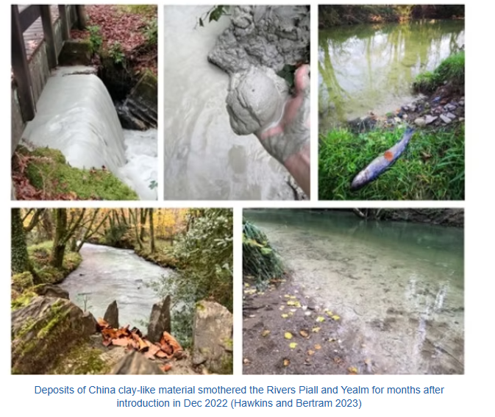
Pollution event reporting
​
​The “Yealm Dippers” have reported a number of transient pollution incidents to the Environment Agency (EA), towards helping identify sources of pollution as may possibly include China clay works, sewage treatment works and surface water runoff.
Most importantly, based mainly upon inputs from “Yealm Dippers”, the RYWQG collated a 23 page report tendered to the EA evidencing a critical incident involving release of China clay-like material in December 2022, which material smothered the beds of Rivers Piall and Yealm for months thereafter, during winter months when fish eggs normally develop.

Slide 8
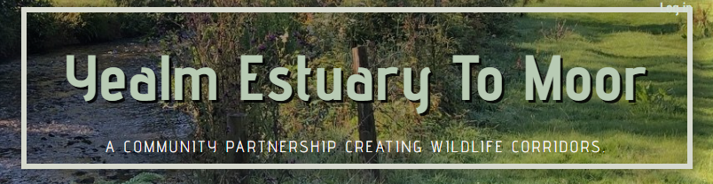
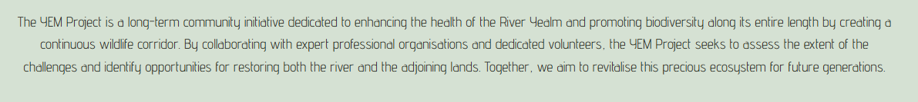

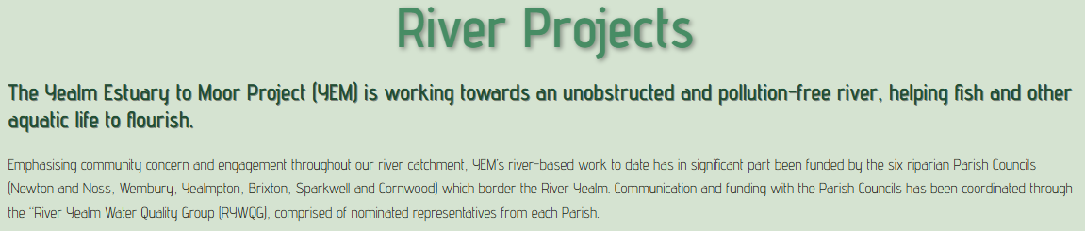

Slide 9
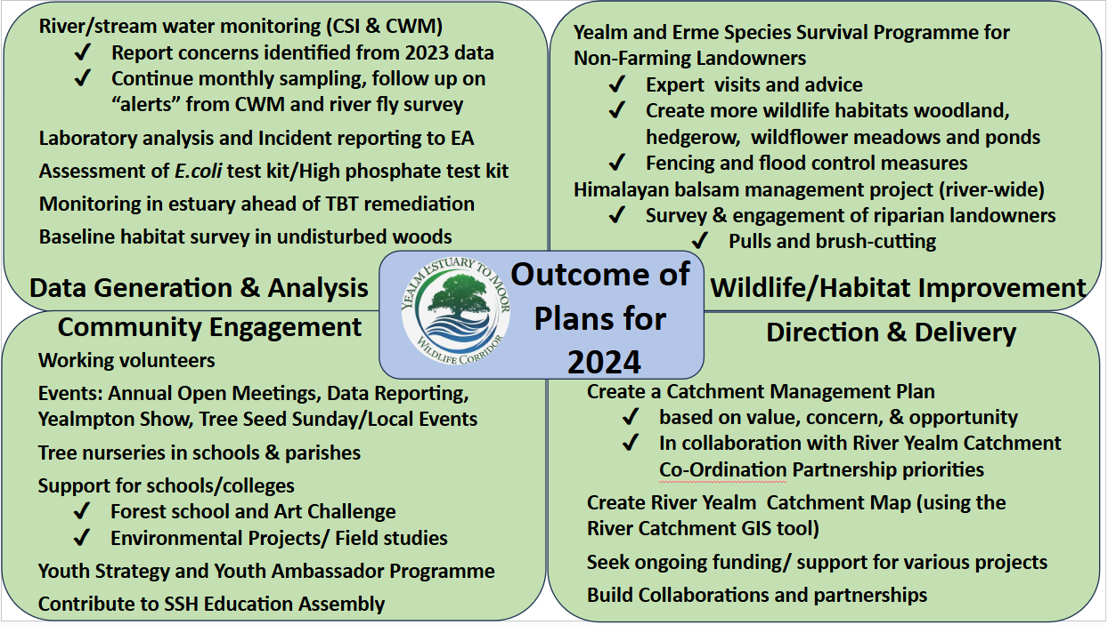
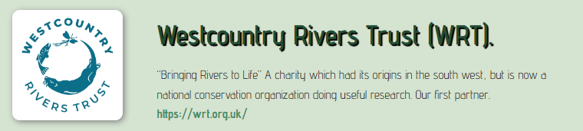
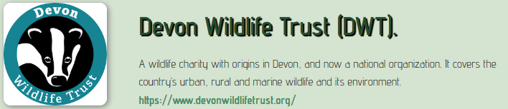
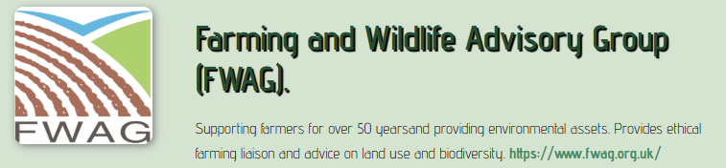
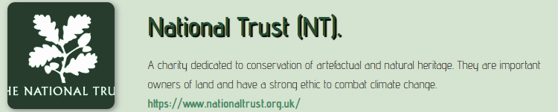
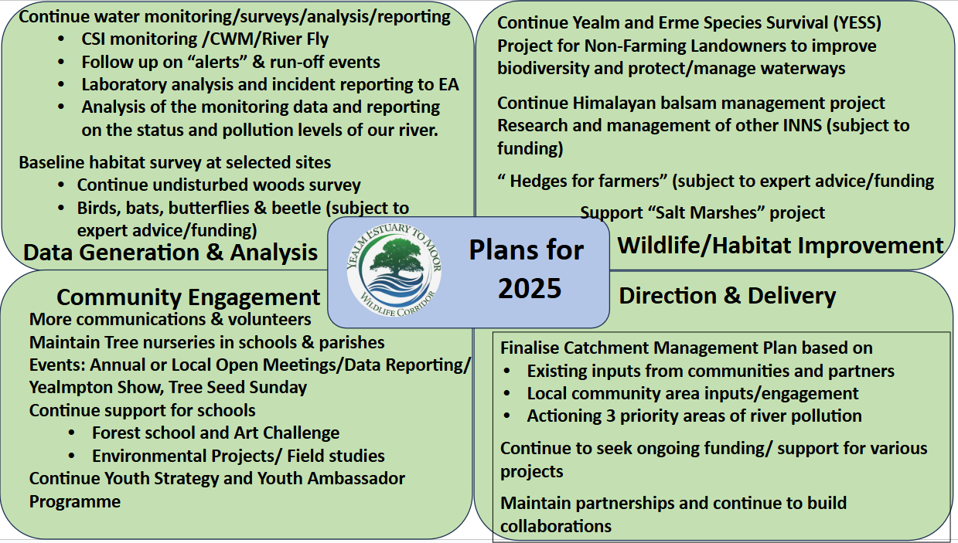
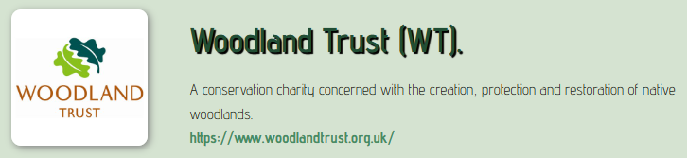
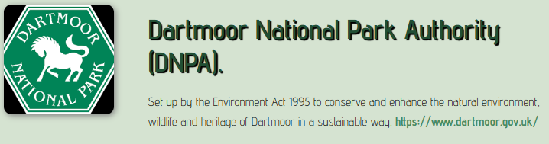

Slide 10
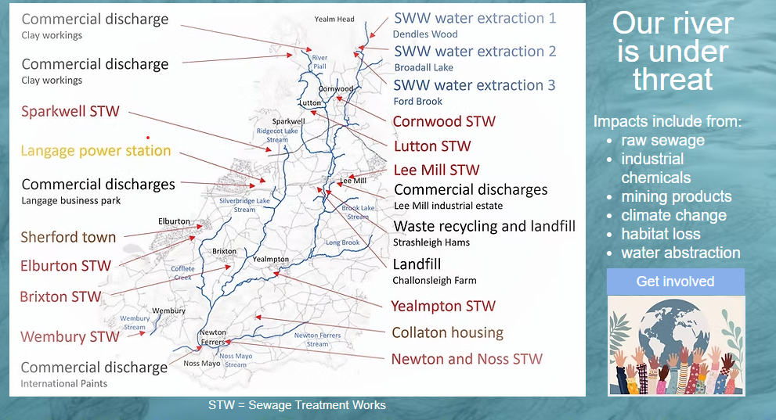
The Main Message!

